Slide 1
Industrial Organization: Shopping Lecture
By Diomides Mavroyiannis
Email: Dmavroyiannis8@gmail.com

Slide 2

Is it this?

Slide 3
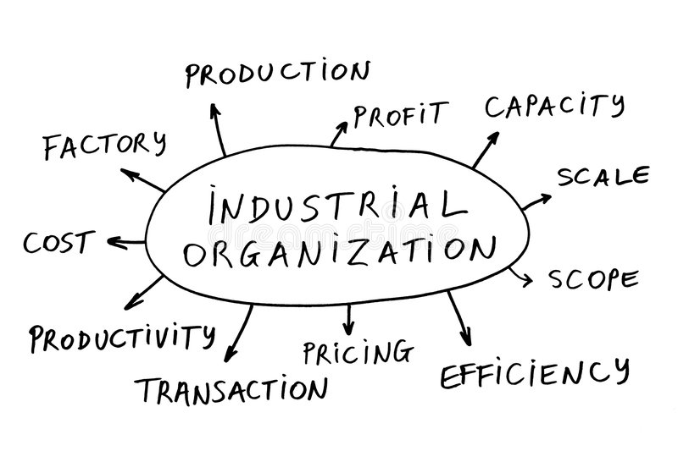
More like this!

Slide 4
What will we learn?
What is efficiency? (Allocative, investment, etc)
Example: When to settle down?
Allocation: Find the ONE
Investment: Build a relationship

Slide 5
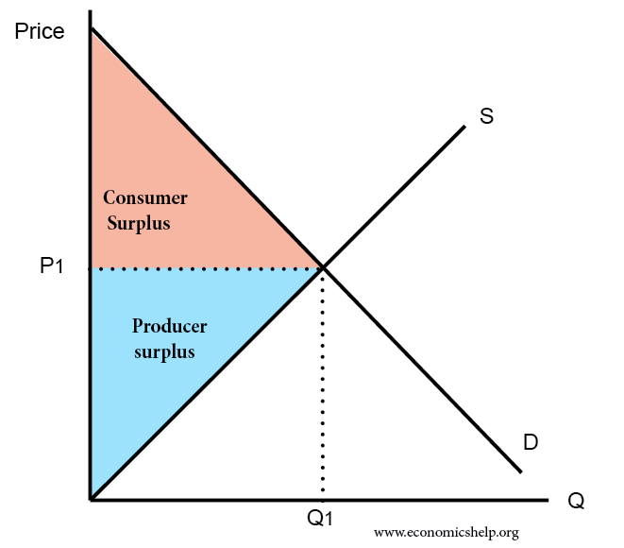
Effects of surplus sharing

Slide 6
Firms? Do we need them?
Why are firms useful?
Example: Why not just outsource everything?
Managers vs owners

Slide 7
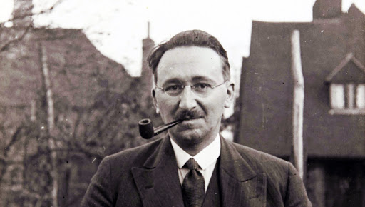

Is advertising helping?
Notes:
Galbraith vs Hayek

Slide 8
Concepts we will use
Price or quantity?(Nash) Bertrand Vs Cournot
First mover advantage(Sequential equilibrium) Stackelberg
Can you compete with yourself?(Durable goods)

Slide 9
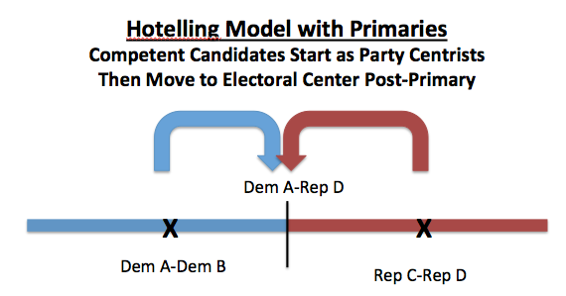
Why might politics be boring?

Slide 10
Requirement
Only requirement is Calculus
We will use some concepts from game theory and microeconomics but these will be introduced
Math-Essay(50-50)
Read papers

Slide 11
Assesement
Weekly group projects, 30%
Individual assignments, 30%
Challenge questions, 10%
Class participation, 10%
Final exam, 20%

